Slide 1






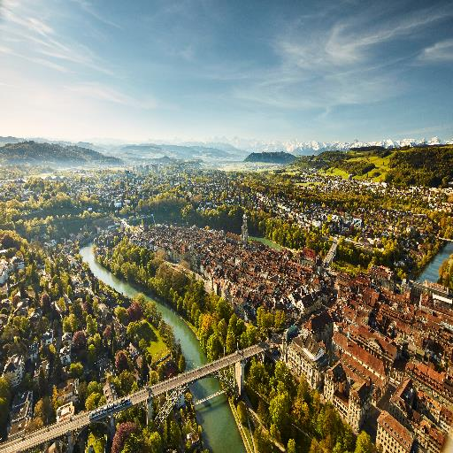



Slide 2




Academy 18 – 20 October 2024
Conference 22 – 25 October 2024
City Festival 22 – 25 October 2024
Highlight 24 October 2024

Slide 3

Call for Abstracts: until 28 January, 2024
More Information?
www.phpci2024.org

